Slide 1
VIRTUAL WALLET
PROJECT GUIDE :
Dr R.VIDHAPRIYA

Slide 2
08I520 – MINI PROJECT – I
BATCH MEMBERS :
10I303 V.ASHOK KUMARESHEN
10I331 MOHAMED ARIF
10I338 T.RAGHUL
10I349 U.SRIRAM KOUSHIK
10I358 S.J.VISHWANATHAN
11I464 S.P.GOKUL

Slide 3
INTRODUCTION
VIRTUAL WALLET is the realization of the concept of easy money transaction using mobile phones based on NFC (Near Field Communication) Technology .
NFC enables data transmission within a range of 4cm radius.
Through VIRTUAL WALLET an user is entitled to make cash transactions either by tapping the phone over a suitable tag device or bringing it to close proximity with the tag.

Slide 4
VIRTUAL WALLET is an application devised for the NFC enabled Nokia Symbian Belle OS phones.
The application is developed having the Nokia C7 mobile phone model as the basic framework model.
Through the use of VIRTUAL WALLET we eliminate the conventinal use of credit cards.

Slide 5
CURRENT CASH TRANSACTION SYTEM
The current cash transaction system involves a credit card , a credit card swiper which reads data from the credit card , authenticates and proceeds with the cash transaction.
Alternate way is to pay through cash.

Slide 6
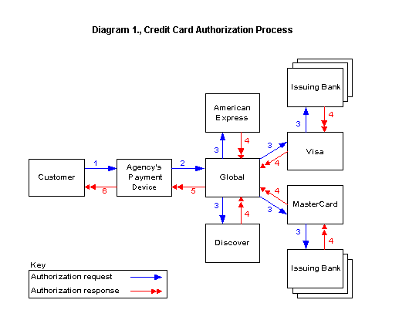

Slide 7
DISADVANTAGES OF THE CURRENT SYTEM
A credit card can be misused by someone else other than the destined owner.
Large valued transactions cannot be carried out by mere cash.
Credit card transactions more prone to hacks.

Slide 8
PROPOSED VIRTUAL WALLET SYTEM
VIRTUAL WALLET system enables a user to transfer money through mobile phones using NFC technology.
The basic sequence diagram of the sytem :

Slide 9
COMPUTER SYSTEM
NFC ENABLED PHONE
FACE AUTHENTICATION SYSTEM
VIRTUAL WALLET APPLICATION
TAP / OR CLOSER CONTACT
NFC TAG DEVICE
CREDIT /PREPAID CARD DETAILS STORAGE

Slide 10
MODULES INVOLVED
Face recognition authentication system
User interface for the application
Synchronizing with the tag device
A computer application for simple billing purposes

